Slide 1

USED CAR PRICE PREDICTION
Under the Guidance of Professor
By Suneel, Sowmya

Slide 2

Motivation
“Autos sales” is one of the major producers of domestic automobiles report sales.
Car price prediction especially when the car is used and not coming direct from the factory, is both a critical and important task.
There is a need of accurate price prediction mechanism for the used cars which can express the changes in economy precisely.
Prediction techniques of machine learning can be helpful in this regard.
It is common to lease a car in many countries rather then buying a new car.

Slide 3
Objectives
The main objective of our project is to predict the price of the used car data.
To compare the difference between the actual price and predicted price.
Using this difference, to improve our model close enough to the actual model.

Slide 4
Methodology
Dataset from Kaggle
Data Cleansing
EDA
Visualizations
Models

Slide 5
Dataset
Source of data : https://www.kaggle.com/
Datapoints: 370000
Years : 1923 to 2016

Slide 6
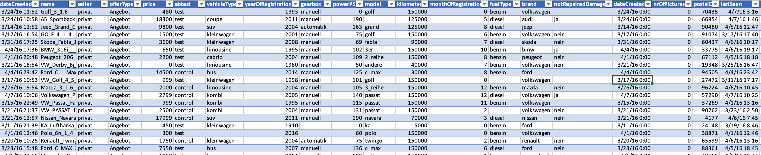

Sample Data Set View

Slide 7
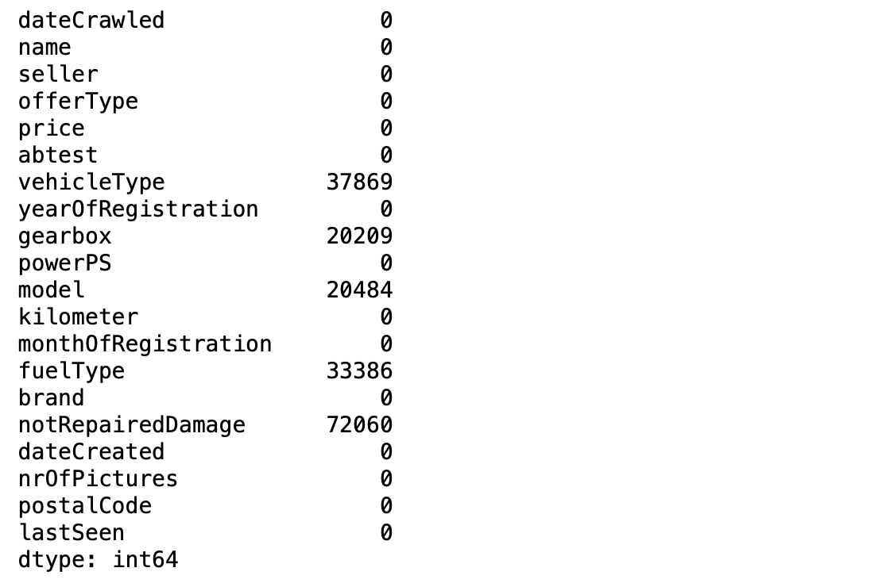
Data Cleansing
Reformatted existing columns for easier analysis.
Column with Nan are dropped.
Conversion of few columns to datetime and integer values as needed for analysis.

Slide 8
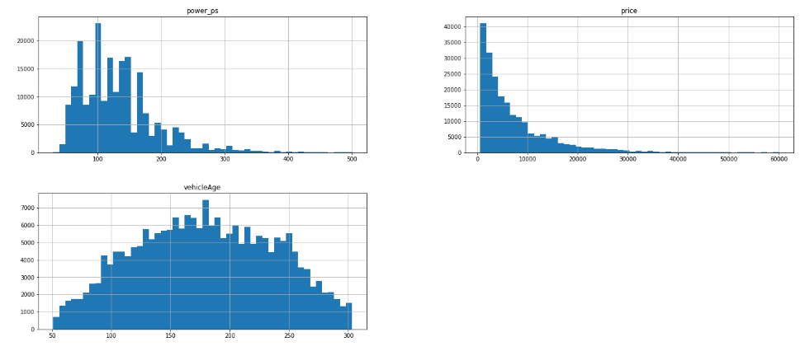
Exploratory Data Analysis
Price outliers
Price >= 600 and Price <= 60000
Registration Year
Year >=1995 and Year <=2015
Power_pS
Power_ps >=30 and Power_ps <=500
VehicleAge

Slide 9
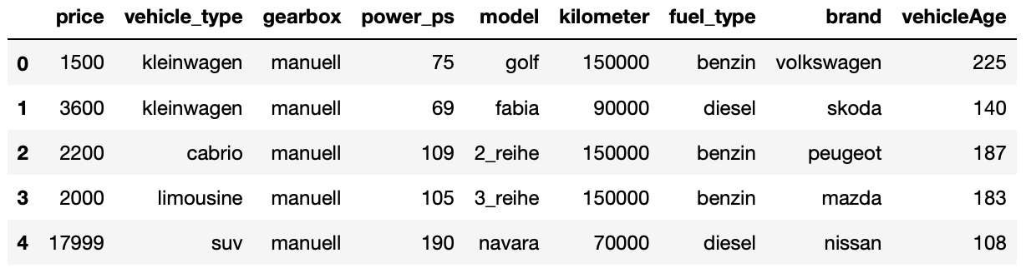
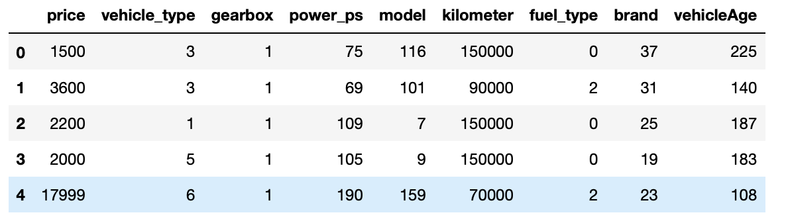
Encoding Character Columns

Slide 10
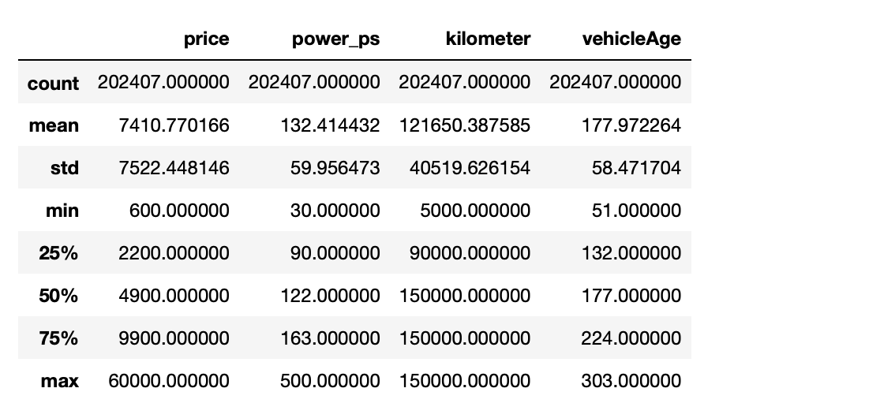
Summary Statistics

Slide 11
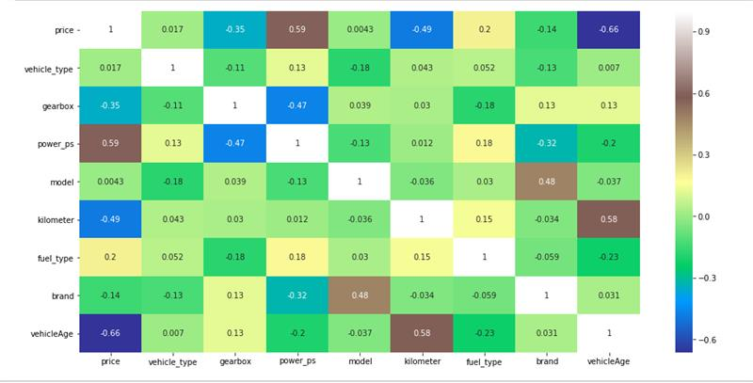
Correlation Heat Map

Slide 12
Models Used
Linear Regression Model
K_Nearest Neighbors Model
Artificial Neural Network – MLP Regressor
Decision Tree Regression Model
Random Forest Regression Model

Slide 13

Training Set and Test Set
Data has been divided into training and test data.
80% of train data
20% of test data

Slide 14
Model Building
Each Model is constructed that enables us to predict the value of new data considering the training data used to train the model.
Fit or Train the training data for each model.
Evaluate prediction accuracy score for each model.
Calculate the Root Mean Square Error(RMSE) for each model.

Slide 15
Linear Regression Model

Slide 16
K-Nearest Neighbors

Slide 17
Artificial Neural Network – MLP Regressor

Slide 18
Decision Tree Regression Model

Slide 19
Random Forest Regression Model

Slide 20
Comparisons of All Models

Slide 21
Summaries of Training and Test Data
Models | Accuracy (%) | Root Mean Square Error | Mean Absolute Error
Linear Regression | 71 | 3973.27 | 2748.941
K-Neighbors | 88 | 2623.52 | 1406.71
Artificial Neural Networks | 77 | 3562.16 | 2230.81
Decision Tree | 87.5 | 2628.01 | 1587.78
Random Forest | 93.4 | 1943.22 | 1101.34

Slide 22
Potential Uses and Application
Developing countries adopt lease culture instead of buying a car due to affordability.
There is a need for a used car price prediction system to effectively determine the worthiness of the car using a variety of features.

Slide 23
Summary
We evaluated used-car price prediction using Kaggle dataset which gives an accuracy of 93% with Random Forest Model.
The most relevant features used for this prediction are price, year, Power_ps, and vehicle Age by filtering out outliers and irrelevant features of the dataset.
This model gives us good accuracy when compared to the other models.

Slide 24
Further Improvement
To collect data for more car details
More information of cars in the current dataset
To adjust model hyperparameters, by using Randomized Search CV
https://scikit-learn.org/stable/modules/generated/sklearn.model_selection.RandomizedSearchCV.html

Slide 25


